Slide 1
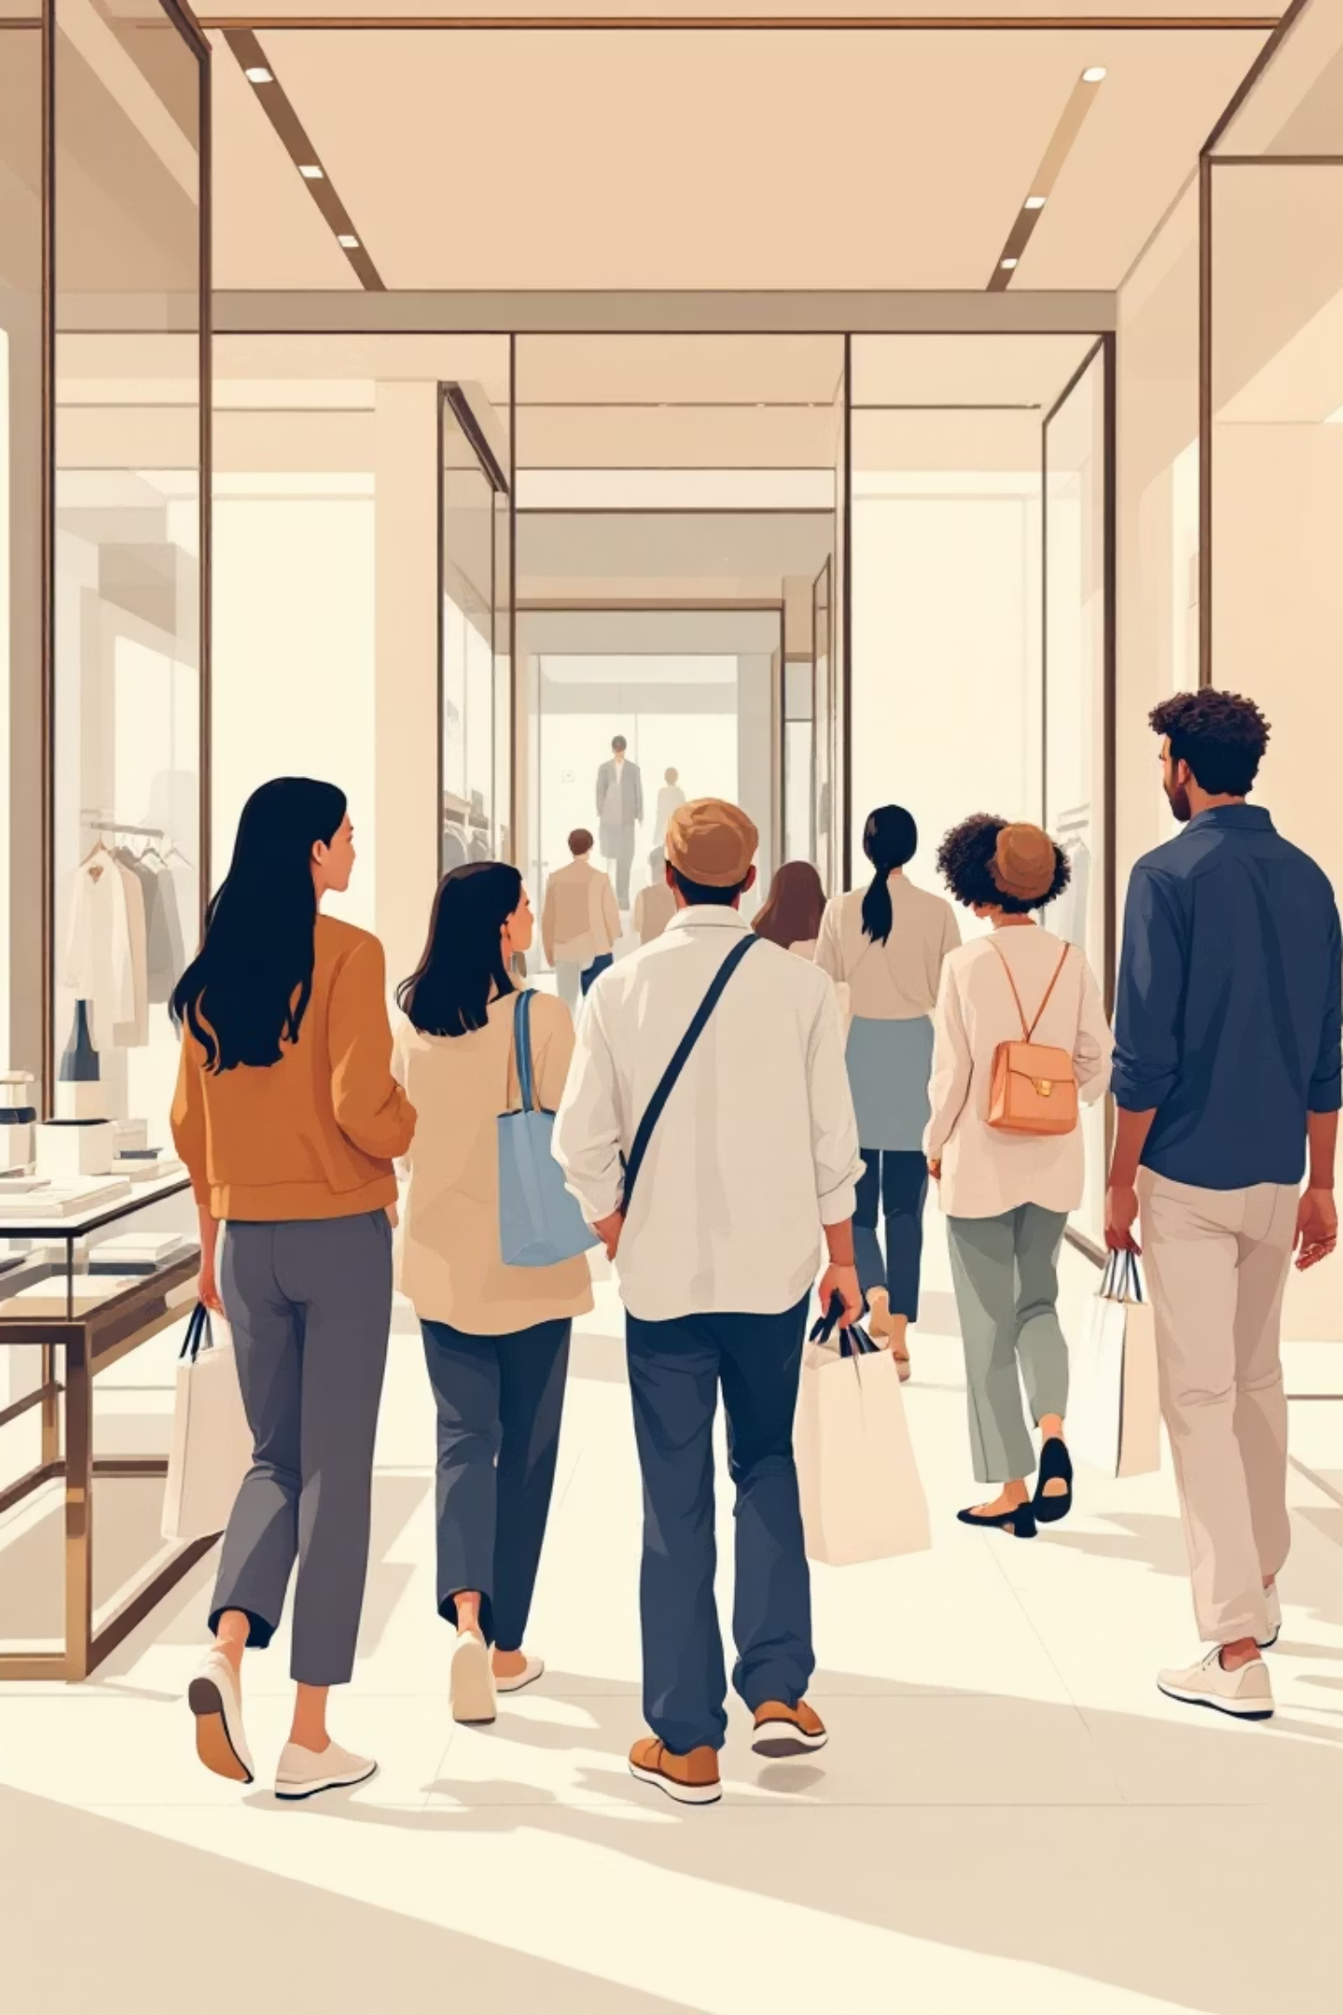
Customer Shopping Behavior Analysis
Uncovering insights from 3,900 purchases to guide strategic business decisions

Slide 2
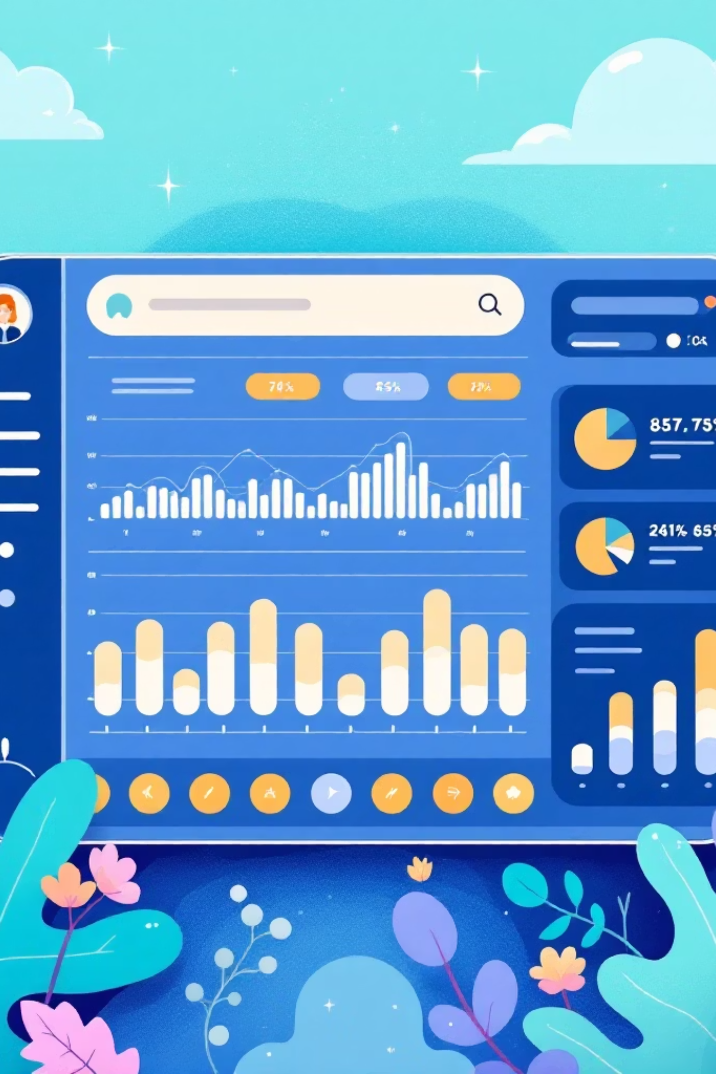
DATASET OVERVIEW
The Foundation
3,900
18
Total Purchases
Data Points
Transactions analyzed across all categories
Features per customer transaction
50
4
Locations
Categories
Geographic coverage across regions
Product segments tracked

Slide 3

PYTHON ANALYSIS
Data Preparation & Cleaning
01
02
03
Data Loading
Exploration
Missing Data
Imported dataset using pandas for analysis
Used df.info() and .describe() for summary statistics
Imputed 37 missing Review Ratings using median by category
04
05
Feature Engineering
Database Integration
Created age_group and purchase_frequency_days columns
Connected to PostgreSQL for SQL analysis

Slide 4
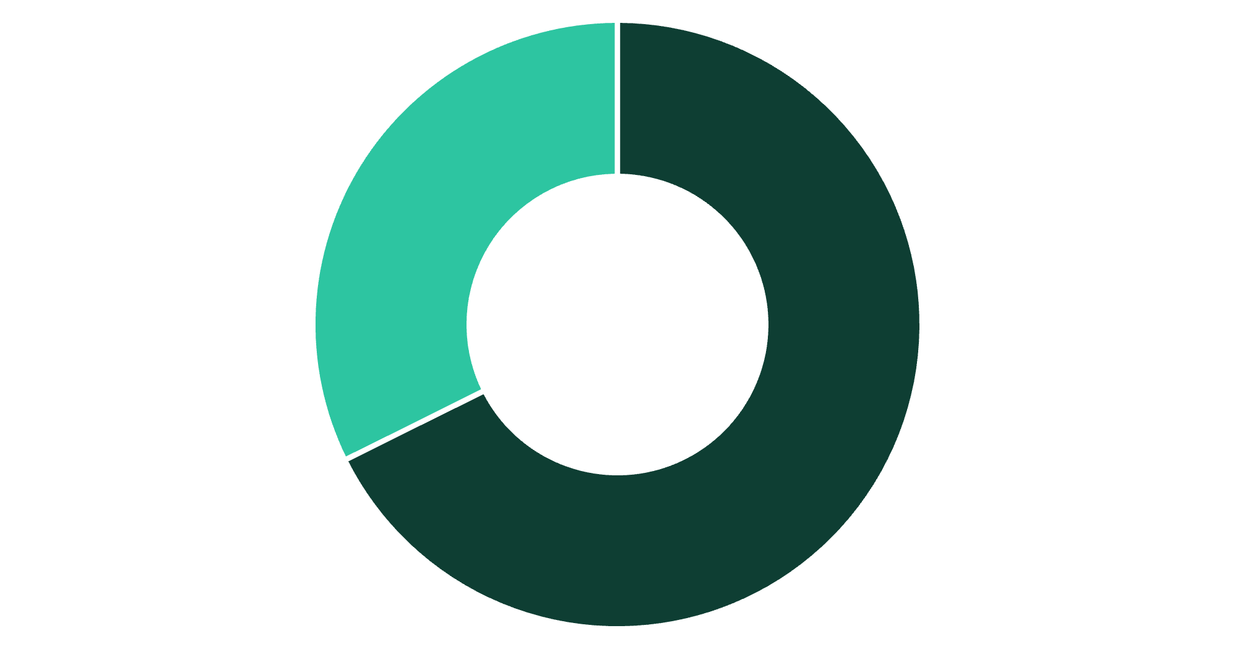
SQL INSIGHTS
Revenue by Gender
Male customers drive 68% of total revenue
Male shoppers generated $157,890 compared to $75,191 from female customers
This significant gap suggests opportunities for targeted marketing to female segments
Male
Female

Slide 5

Customer Spending Patterns
High-Spending Discount Users
Express Shipping Premium
839 customers used discounts but spent above average ($59.76)
Express: $60.48 avg vs Standard: $58.46 avg purchase amount
Top-Rated Products
Gloves (3.86), Sandals (3.84), Boots (3.82) lead ratings

Slide 6
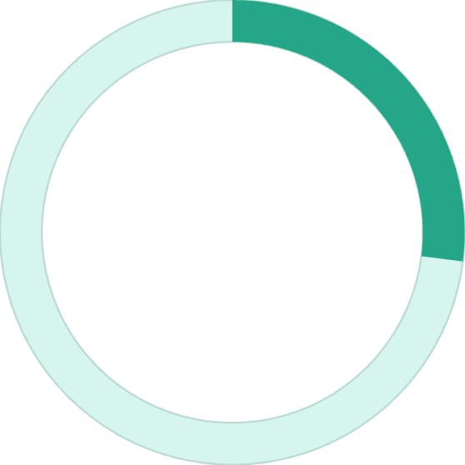
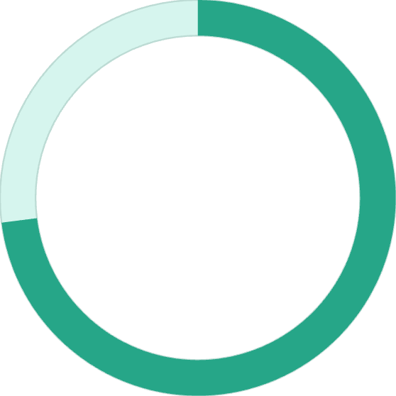
SUBSCRIPTION ANALYSIS
Subscribers vs Non-Subscribers
Similar spending patterns
Subscribers: $59.49 avg spend, $62,645 total revenue
Non-subscribers: $59.87 avg spend, $170,436 total revenue
27%
Massive untapped potential in non-subscriber segment
Subscribers
1,053 customers with subscriptions
73%
Non-Subscribers
2,847 customers without subscriptions

Slide 7



Customer Segmentation
New
83 customers
Returning
701 customers
Loyal
3,116 customers
80% of customers classified as Loyal - strong retention foundation
958 repeat buyers (>5 purchases) show higher subscription rates

Slide 8
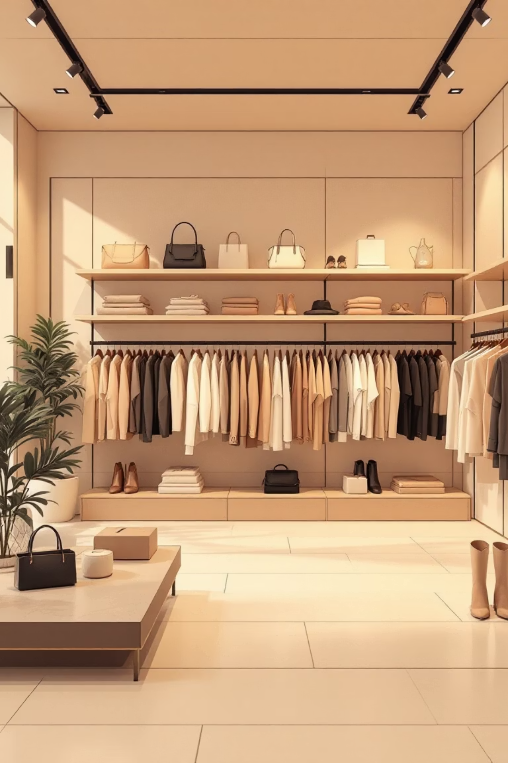
PRODUCT PERFORMANCE
Top Products by Category
1
Clothing
Blouse (171), Pants (171), Shirt (169)
2
Accessories
Jewelry (171), Sunglasses (161), Belt (161)
3
Footwear
Sandals (160), Shoes (150), Sneakers (145)
4
Outerwear
Jacket (163), Coat (161)
Hat, Sneakers, and Coat show highest discount dependency at ~50% discount rate

Slide 9
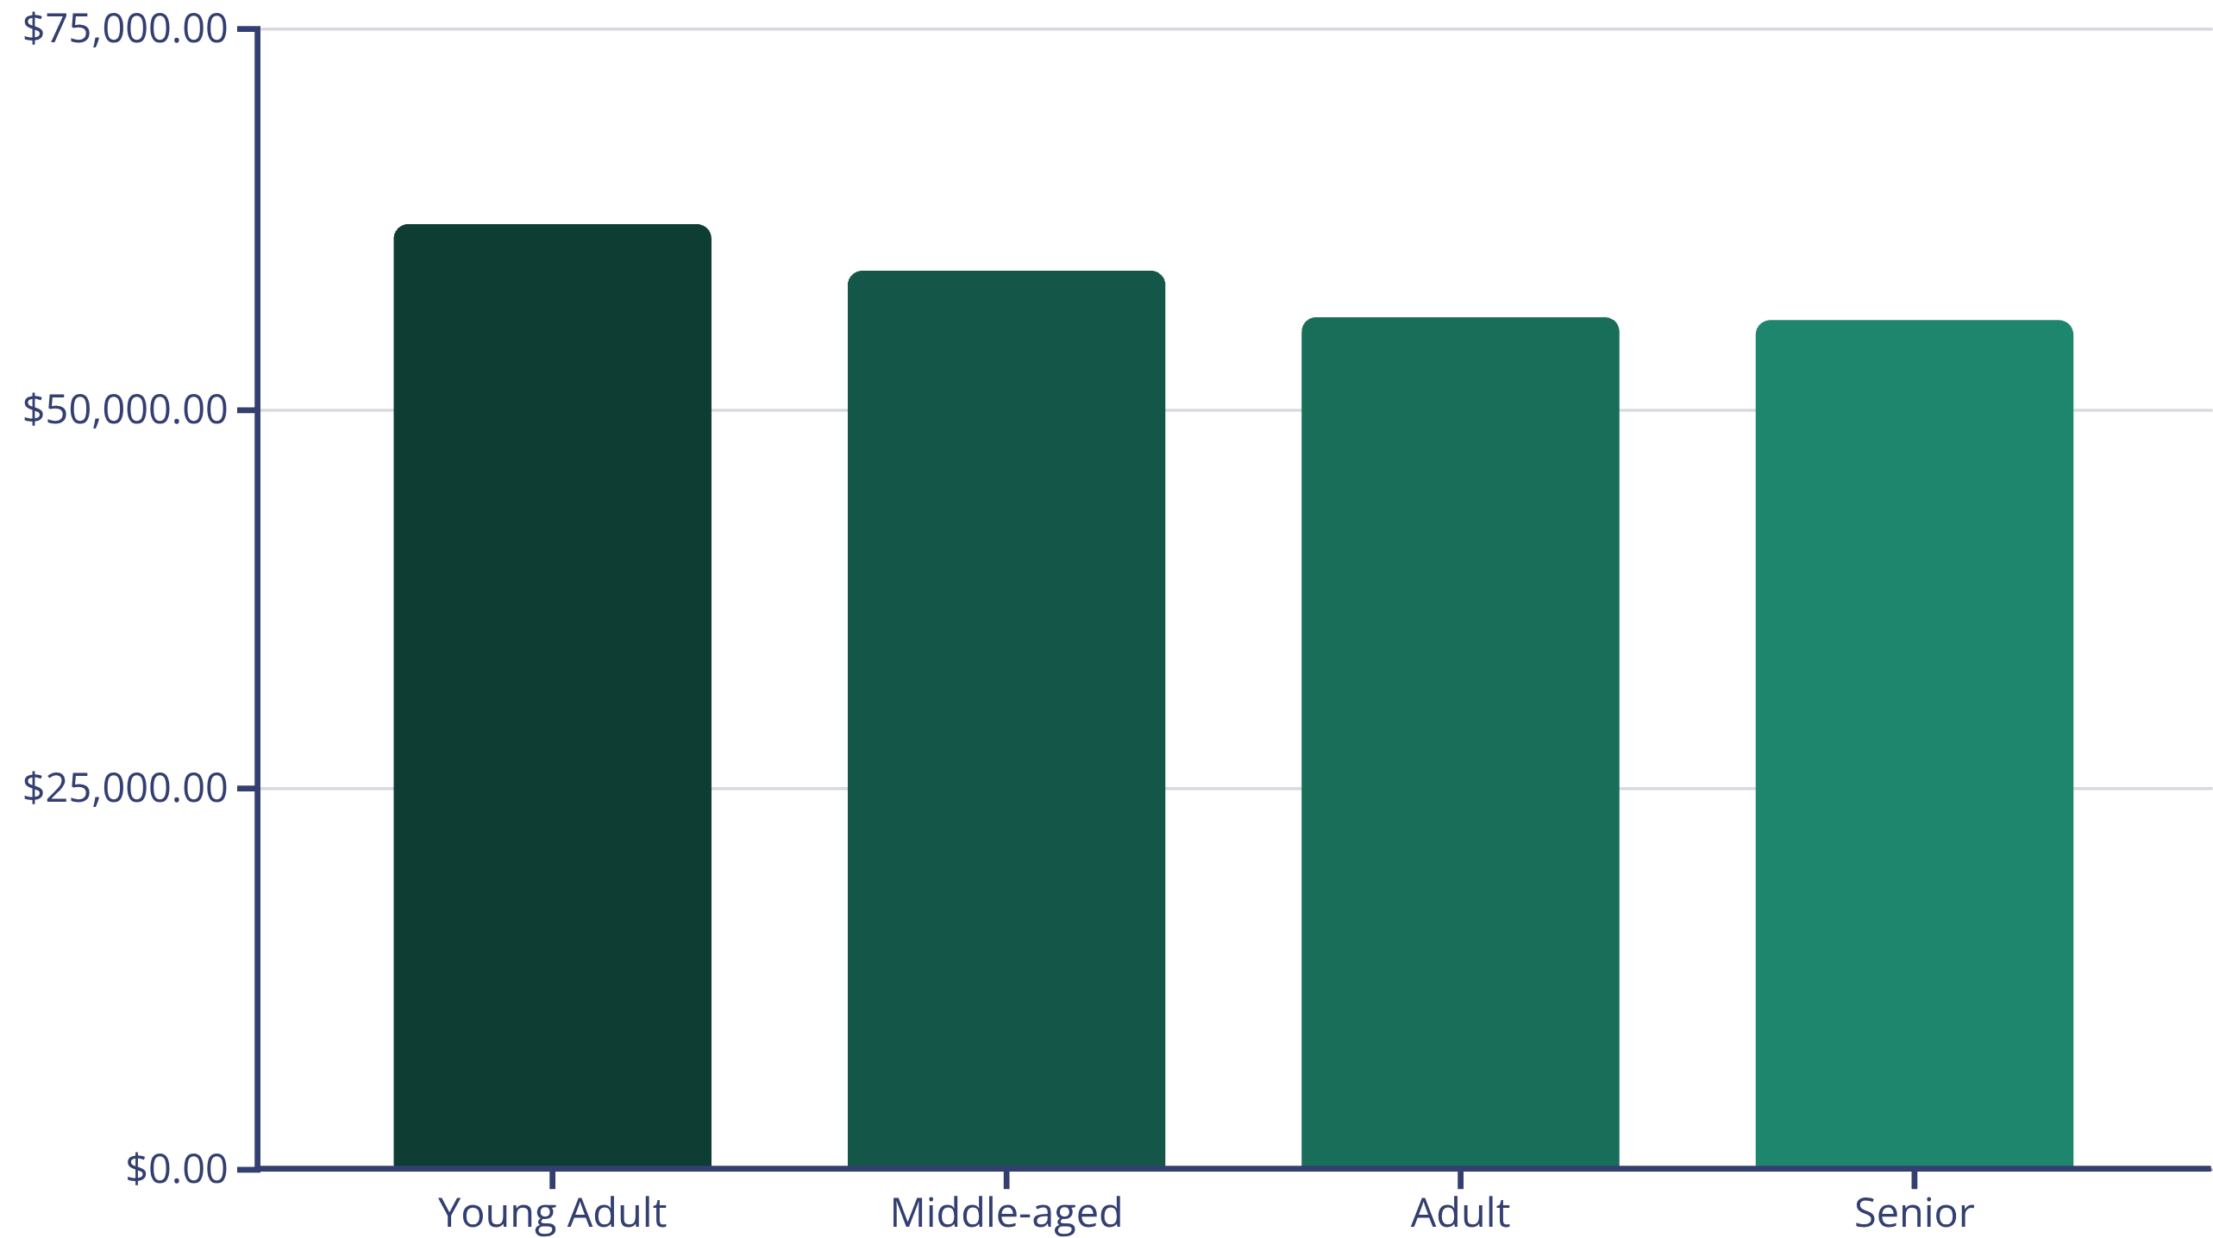
DASHBOARD INSIGHTS
Revenue Distribution
Young Adults lead revenue generation, followed closely by Middle-aged customers
Relatively balanced distribution across age groups presents opportunities for targeted campaigns

Slide 10





STRATEGIC RECOMMENDATIONS
Action Plan for Growth
Boost Subscriptions
Promote exclusive benefits to convert 73% non-subscriber base
Loyalty Programs
Reward repeat buyers to strengthen 80% loyal customer segment
Review Discount Policy
Balance sales boosts with margin control on high-discount products
Targeted Marketing
Focus on high-revenue age groups and express-shipping users
Product Positioning
Highlight top-rated items (Gloves, Sandals, Boots) in campaigns

